Slide 1
GSA’s Vendor and Customer Self Service (VCSS)
Notes:
Hello and welcome to GSA’s Vendor and Customer Self Service (VCSS) training course. This course has been developed to walk you through the navigation and functionality of VCSS. You are listening to Segment 1, Introduction

Slide 2
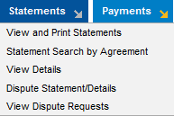
Statements Menu
View and Print Statements
View and print statements for your accounts.
Statement Search by Agreement
Search for and view statements by your GSA
agreement number.
View Details
View details for statements on your accounts.
Dispute Statement/Details
Dispute a statement that you think might be in error (for non-IPAC statements only).
Disputes of IPAC bills should be performed via Treasury IPAC guidelines using the chargeback process.
View Dispute Requests
View dispute requests and status of your disputes.
E1
Notes:
We are now going to walk through each of these Statements options in this section.

Slide 3
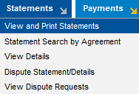
View and Print Statements
The Statement Search page is used to search for, view, and print statements for your accounts.
View statements as Portable Document Format (PDF) files to print.
Create and view statement correspondence to send to GSA.
Statement correspondence are messages regarding a specific statement on your account.
This correspondence should not be related to a general account issue or question, or a specific refund or payment on your account because there are specific types of correspondence that should be created for these.
Dispute a statement that you think might be in error.
View dispute requests and status associated with a statement.
To access the Statement Search page, from the menu bar select Statements > View and Print Statements.
E2

Slide 4
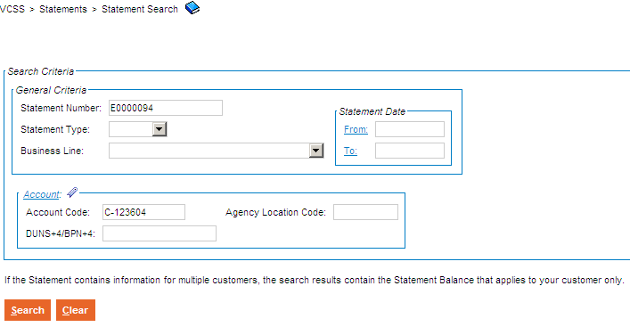
View and Print Statements (Cont’d)
Statement Search page
The Statement Search page displays with a search criteria area to search for statements associated with your account.
Enter search criteria and select the [Search] button.
E3
Notes:
The Statement Search page displays, with a search area to enter search criteria to search for statement records.

Slide 5
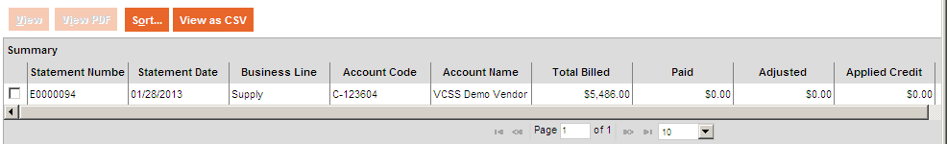
View and Print Statements (Cont’d)
Statement Search page
In the search results, review the statement records.
E4
Notes:
After running the search for statement records, review the search results in the search results.
In the search results you have several options:
Select the [View] button to view more details for a statement.
Select the [View PDF] button to view a PDF version of a statement.
Select the [Sort] button to sort the statement records.
Select the [View as CSV] button to export the statement records to a spreadsheet.
We are now going to review some of these options.

Slide 6
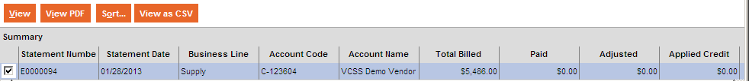
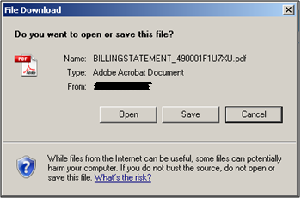
View and Print Statements (Cont’d)
Statement Search page
To view a PDF version of a statement, select a statement record and then select the [View PDF] button.
In the file download pop-up window, select the [Open] button to open the PDF version of the statement.
E5
Notes:
To view a PDF version of a statement, select the statement record and select the [View PDF] button.

Slide 7
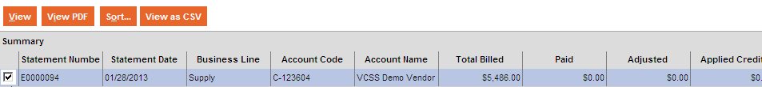
View and Print Statements (Cont’d)
Statement Search page
To view detailed information associated with a statement, select a statement record and then select the [View] button.
E6
Notes:
You can view the detailed information associated for a statement by selecting a statement record and then clicking the [View] button.

Slide 8
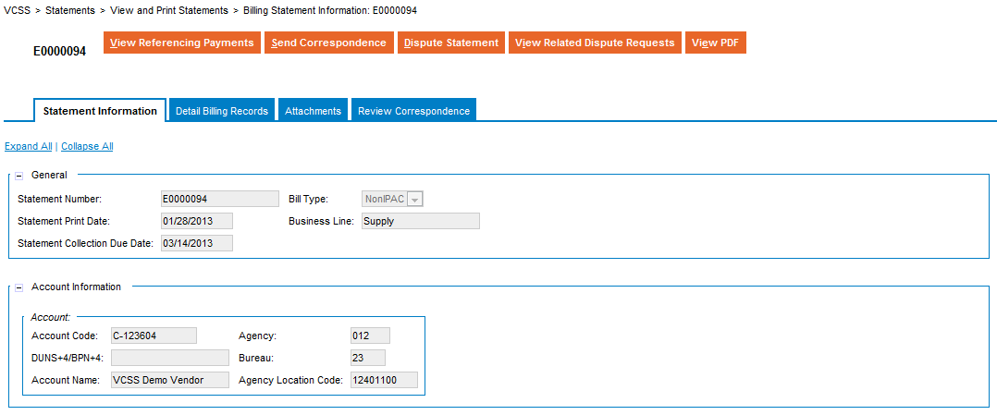
View and Print Statements (Cont’d)
Statement Record
The statement record has the following action buttons at the top of the record:
Select the [View Referencing Payments] button to view payments made on this statement.
Select the [Send Correspondence] button to send correspondence to GSA regarding this statement.
Select the [Dispute Statement] button to dispute this statement.
Select the [View Related Dispute Requests] button to view all dispute requests associated with this statement.
Select the [View PDF] button to view a PDF version of this statement.
E7
Notes:
In BAAR Phase 2 HOTD began charging customers for actual usage of chilled water and steam rather than an estimated monthly charge.
When you view a statement record, you have the following options action buttons:
Select the [View Referencing Payments] button to review payments made on this statement.
Select the [Send Correspondence] button to create correspondence to send to GSA regarding this statement.
Select the [Dispute Statement] button to dispute this statement.
Select the [View Related Dispute Requests] button to view open dispute requests associated with this statement.
Select the [View PDF] button to view a PDF version of this statement.

Slide 9
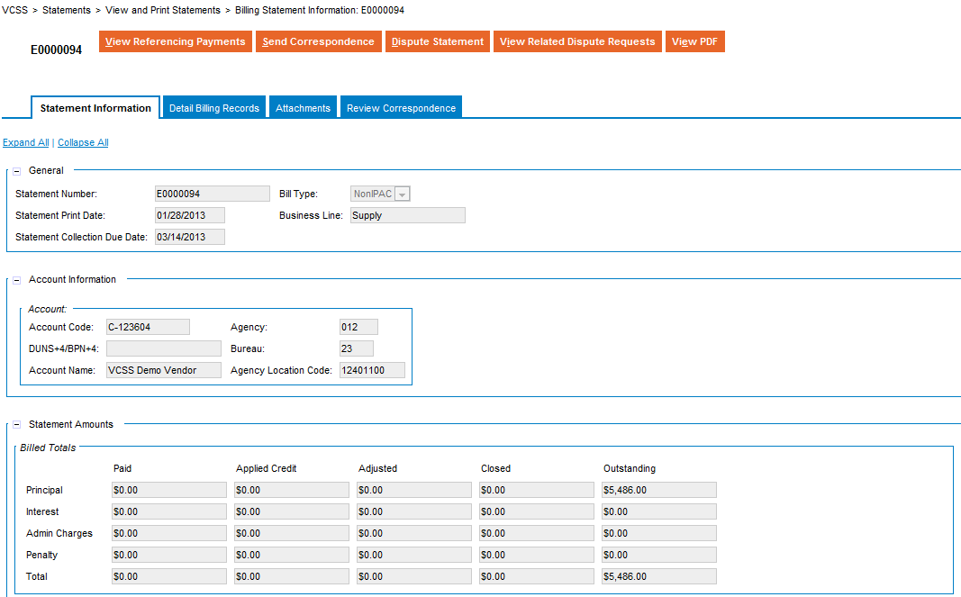
View and Print Statements (Cont’d)
Statement Record
The statement record opens and displays in a tab-like format. The first tab is the Statement Information tab and contains detailed information about the statement, including amounts.
E8
Notes:
The statement record’s Statement Information tab displays. Review general information about the selected statement including account information, and statement amounts.

Slide 10
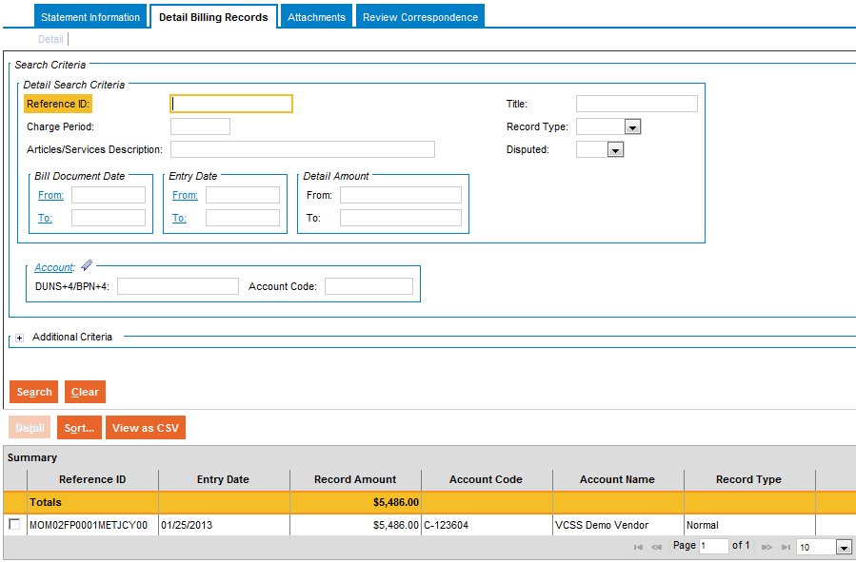
View and Print Statements (Cont’d)
Statement Record
Within the statement record, select the Detail Billing Records tab to review the details associated with the statement in the search results.
Note: Statement details are only available for customers doing business with GSA's Fleet, Rent, Global Supply, and Automotive Purchases business lines.
If you have access to a large number of detail records, you may want to enter search criteria and select the [Search] button to limit the search results to a manageable number.
E9
Notes:
Select the Detail Billing Records tab to review detail records associated with this statement, which are pre-populated in the search results.
You can filter the search results by entering search criteria and clicking the [Search] button.

Slide 11
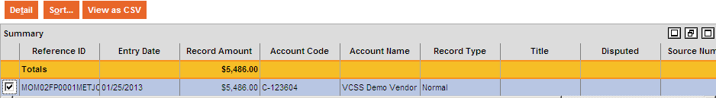
View and Print Statements (Cont’d)
Statement Record
Within the statement record’s Details tab, to view more detailed information for a statement detail record, select a detail record and then select the [Detail] button.
Note: Statement details are only available for customers doing business with GSA's Fleet, Rent, Global Supply, and Automotive Purchases business lines.
E10
Notes:
To review the details of a detail record, select a details record and select the [Detail] button.

Slide 12
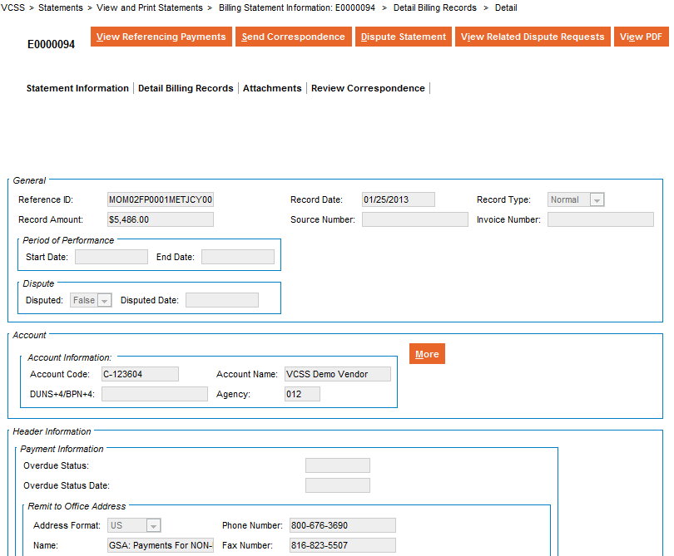
View and Print Statements (Cont’d)
Detail Record
The detail record opens and displays with detail record information.
Note: Statement details are only available for customers doing business with GSA's Fleet, Rent, Global Supply, and Automotive Purchases business lines.
E11
Notes:
Review the detail record that opens.

Slide 13
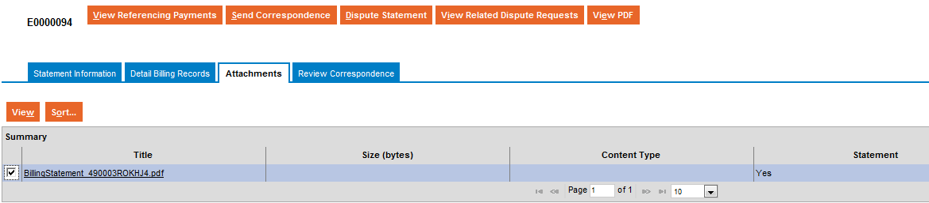
View and Print Statements (Cont’d)
Statement Record
Within the statement record, select the Attachments tab to review supporting documentation associated with this statement.
Select an attachment record and then select the [View] button to open an attachment.
E12
Notes:
Select the Attachments tab to review supporting documentation that is associated with this statement.

Slide 14
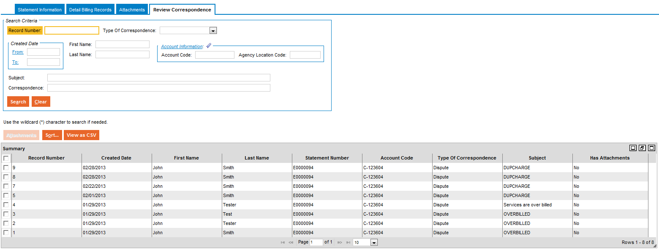
View and Print Statements (Cont’d)
Statement Record
Within the statement record, select the Review Correspondence tab to review correspondence associated with this statement in the search results.
E13
Notes:
Select the Review Correspondence tab to search for and review correspondence associated with this statement, pre-populated in the search results.
To filter the search results, you can enter search criteria and select the [Search] button.
The correspondence records can include correspondence that you or another person, in your organization, has sent to GSA. The records can also include correspondence that GSA has sent regarding this statement.

Slide 15
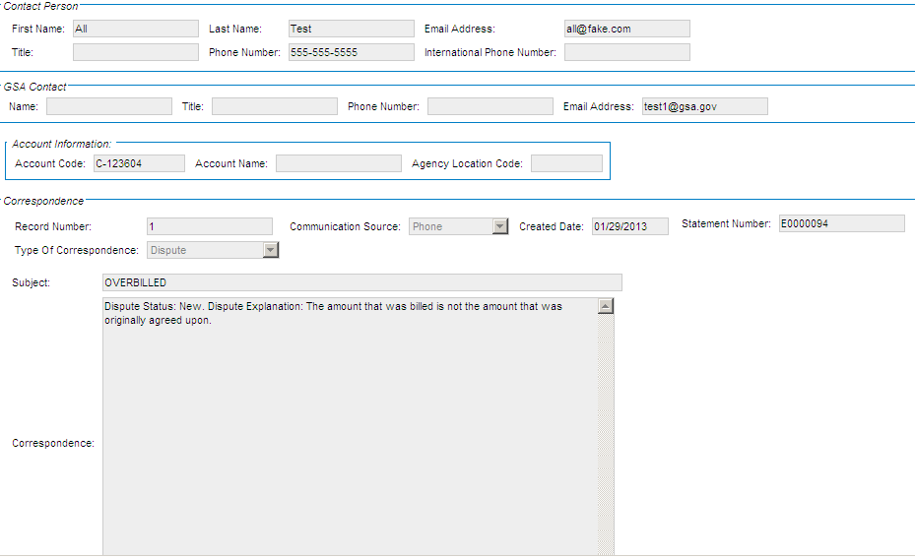
View and Print Statements (Cont’d)
Statement Record
To review the details of a statement correspondence record, select the correspondence record and then review the details that display below the search results.
E14
Notes:
Select a statement correspondence record in order to review the details.

Slide 16
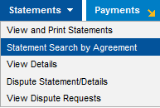
Statement Search by Agreement
The Statement Search by Agreement page is used to search for statements by your GSA Agreement Number.
Provides the ability to search for Statements using Agreement Number (for RWA/HOTD customers, this would be the “RWA Number”).
Search criteria includes:
Agreement Number
IPAC Information (Funding Document, Purchase Order Number, etc.)
Account Information (Account Code, Agency, Bureau, etc.)
Provides the ability to view the Statement by launching the Statement Query pre-searched by the selected number.
To access the Statement Search by Agreement page, from the menu bar select Statements > Statement Search by Agreement.
E15

Slide 17
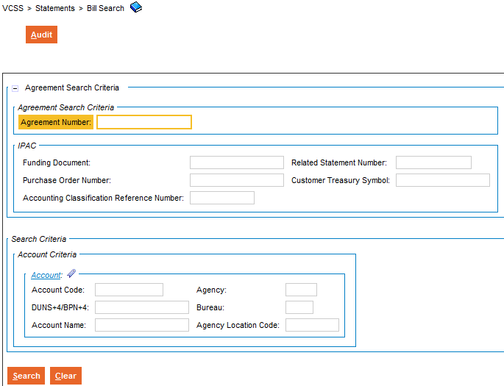
Statement Search by Agreement (Cont’d)
Statement Search by Agreement Page
The Statement Search by Agreement page displays with a search criteria area to search for statements associated with your account.
Enter search criteria and select the [Search] button.
E16
Notes:
The Statement Search by Agreement page displays, with a search area to enter search criteria to search for statements.

Slide 18
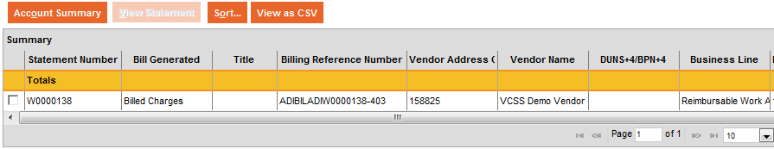
Statement Search by Agreement (Cont’d)
Statement Search by Agreement Page
In the search results, review the statement records.
E17
Notes:
After running the search for statement records, review the search results in the search results.
In the search results you have several options:
Select the [Account Summary] button to view more details for a statement.
Select the [Sort] button to sort the statement records.
Select the [View as CSV] button to export the statement records to a spreadsheet.
We are now going to review some of these options.

Slide 19
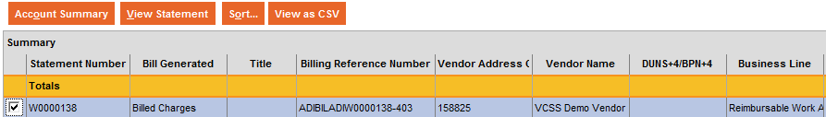
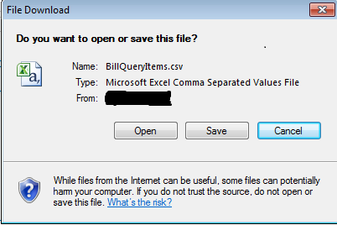
Statement Search by Agreement (Cont’d)
Statement Search by Agreement page
To view detailed information associated with a statement, select a statement record and then select the [View Statement] button.
To view as a CSV file, select a statement record and then select the [View as CSV] button.
In the file download pop-up window select the [OPEN] button to open the CSV version of the statement.
E18
Notes:
You can view the information associated for a statement by selecting a statement record and then clicking the [View Statement] button.

Slide 20
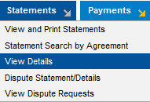
View Details
The Detail Record Search page is used to search for and view details for statements associated with your accounts.
View details for a statement that display as separate records referred to as “detail records”.
Detail records identify the goods/services billed, the statement they are associated with, the business line, and statement dates.
View more detailed information for each statement detail record.
Note: Statement details are only available for customers doing business with GSA's Fleet, Rent, Global Supply, and Automotive Purchases business lines.
Also, export the detail records to a CSV file to view and sort through the records.
To access the Detail Record Search page, from the menu bar select Statements > View Details.
E19
Notes:
Access the Detail Record Search page from the menu bar.

Slide 21
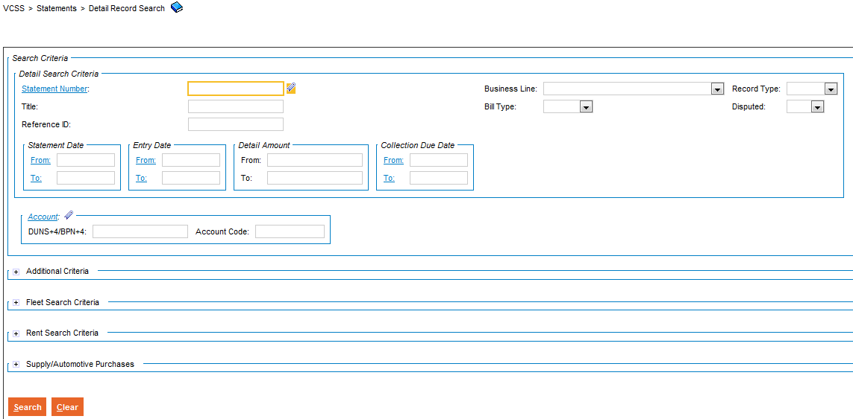


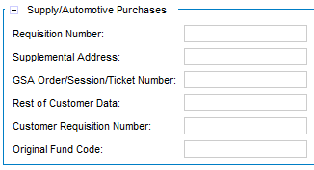
View Details (Cont’d)
Detail Record Search page
The Detail Record Search page displays with a search criteria area to search for details on statements.
Enter search criteria and select the [Search] button.
You can search by business line and can additionally search by specific fields related to the GSA business lines.
Note: Statement details are only available for customers doing business with GSA's Fleet, Rent, Global Supply, and Automotive Purchases business lines.
E20
Notes:
The Detail Record Search page displays, with a search area to enter search criteria to search for detail records.
You can search by business line and can additionally search by specific fields related to the GSA business lines.

Slide 22
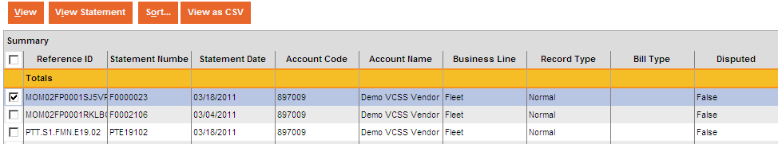
View Details (Cont’d)
Detail Record Search page
In the search results, review the statement detail records.
Note: Statement details are only available for customers doing business with GSA's Fleet, Rent, Global Supply, and Automotive Purchases business lines.
E21
Notes:
After running the search for statement detail records, review the search results.
In the search results you have several options:
Select the [View] button to view more detailed information for a detail record.
Select the [View Statement] button to view the statement associated with the detail record.
Select the [Sort] button to sort the detail records.
Select the [View as CSV] button to export the detail records to a spreadsheet.
We are now going to review some of these options.

Slide 23
View Details (Cont’d)
Detail Record Search
When searching for statement detail records, the search results display up to 1,000 records at a time. Even if your search returns more than 1,000 detail records, up to 1,000 detail records display at once.
If your search returns more than 1,000 detail records, the system will display an informational message stating that your search has returned more than 1,000 records. In order to review all of the records, you have two options:
Select the [View as CSV] button to export all of the detail records to a CSV file.
Select the [Sort] button to re-sort the order of the detail records that display based on sort criteria that you specify. When you sort the detail records, the system sorts through all of the records, even if there are more than 1,000 records.
Detail records can be sorted by columns such as, Statement Number, Statement Date, Account Name, and Business Line.
Note: Statement details are only available for customers doing business with GSA's Fleet, Rent, Global Supply, and Automotive Purchases business lines.
E22
Notes:
It is important to note that if you run a search that returns more than 1,000 statement detail records, the search results cannot display more than 1,000 detail records.
If you want to view more than 1,000 detail records at once, you must choose the [View as CSV] button to export the records to a spreadsheet.

Slide 24
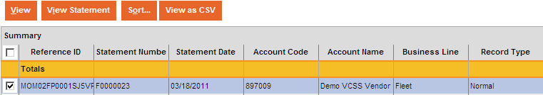
View Details (Cont’d)
Detail Record Search page
To view more detailed information for a detail record, select the detail record and then select the [View] button.
Note: Statement details are only available for customers doing business with GSA's Fleet, Rent, Global Supply, and Automotive Purchases business lines.
E23
Notes:
You can view more detailed information about a detail record by selecting a detail record and then clicking the [View] button.

Slide 25
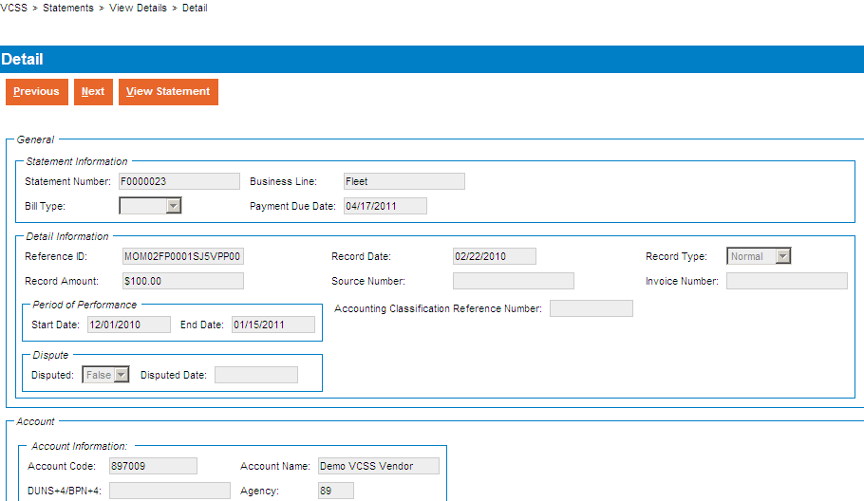
View Details (Cont’d)
Detail Record
The statement detail record opens and displays with detailed information.
From this page you can also do the following:
Select the [Previous] or [Next] buttons to go to the previous or next detail record that appears on the statement.
Select the [View Statement] button to view the statement associated with this detail record.
Note: Statement details are only available for customers doing business with GSA's Fleet, Rent, Global Supply, and Automotive Purchases business lines.
E24
Notes:
The Detail Record displays. On the Detail Record you have the following options:
Select the [Previous] or [Next] buttons to go to the previous or next detail record that appears on the statement.
Select the [View Statement] button to view the statement the detail record is associated with.

Slide 26
View Details (Cont’d)
Detail Record Search
To view the statement associated with a detail record, select a detail record and then select the [View Statement] button.
Note: Statement details are only available for customers doing business with GSA's Fleet, Rent, Global Supply, and Automotive Purchases business lines.
E25
Notes:
Review the statement that a detail record is associated with by selecting a detail record and clicking the [View Statement] button.

Slide 27
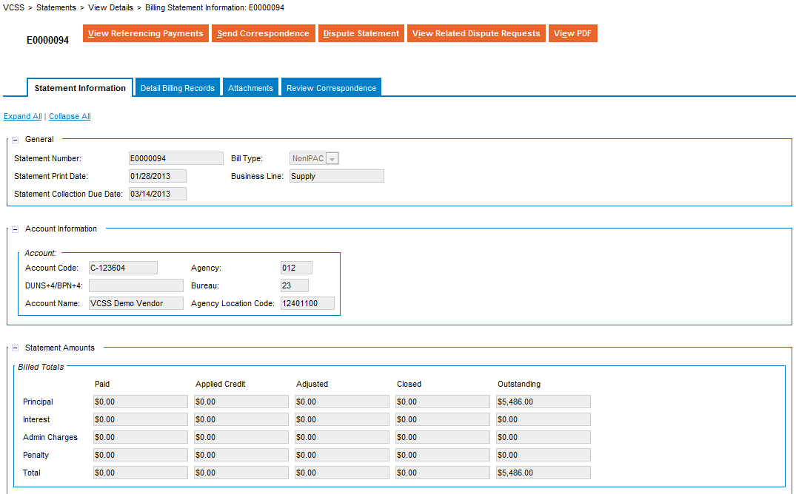
View Details (Cont’d)
Statement Record
The statement record opens and displays in a tab-like format. The first tab that displays is the Statement Information tab which contains detailed statement information. Review the detail billing records associated with this statement, related attachments, and correspondence.
Note: Statement details are only available for customers doing business with GSA's Fleet, Rent, Global Supply, and Automotive Purchases business lines.
E26
Notes:
The Statement Record displays. On the statement record you have the following options:
Review the tabs: Statement Information, Detail Billing Records, Attachments, and Review Correspondence.
Select the [View Referencing Payments] button to review payments made on this statement.
Select the [Send Correspondence] button to send correspondence to GSA regarding this statement.
Select the [Dispute Statement] button to dispute this statement.
Select the [View PDF] button to view a PDF version of this statement.

Slide 28
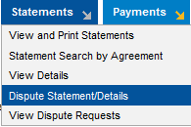
Dispute Statement/Details
The Dispute Statement/Details process is used to dispute an entire statement or specific details of a statement (detail records).
Submit a dispute request if you find the statement might be in error or contain inaccurate information.
To dispute a statement or details associated with a statement, VCSS has a dispute wizard that walks you step-by-step through the dispute submission process.
If you would like to dispute details of a statement, there is an additional step to search for and select the specific detail records you would like to dispute.
Note: Statement details are only available for customers doing business with GSA's Fleet, Rent, Global Supply, and Automotive Purchases business lines.
To access the dispute wizard, from the menu bar select Statements > Dispute Statement/Details.
E27
Notes:
You run through a dispute wizard, where you can choose whether to dispute an entire statement or just specific details of a statement (detail records), that you think might be in error or contain inaccurate information.
Access the Dispute Wizard page from the menu bar.

Slide 29
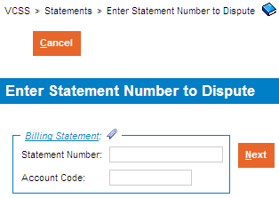
Dispute a Statement
Enter Statement Number to Dispute page
The first page of the dispute wizard displays where you identify the statement you would like to dispute.
Enter the Statement Number and select the [Next] button.
If the statement is associated with more than one account, you must also enter the Account Code.
E28

Slide 30
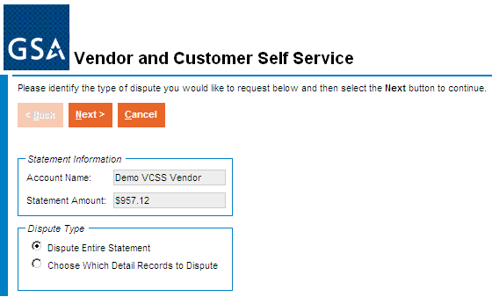
Dispute a Statement (Cont’d)
Select Dispute Type page
The second page of the dispute wizard displays where you identify whether you would like to dispute the entire statement or details of a statement.
To dispute an entire statement, select Dispute Entire Statement and then select the [Next] button.
E29
Notes:
The second page of the Dispute Wizard displays, where you choose whether to dispute the entire statement or just specific details.
If you want to dispute the entire statement, make sure to select the Dispute Entire Statement radio button.

Slide 31
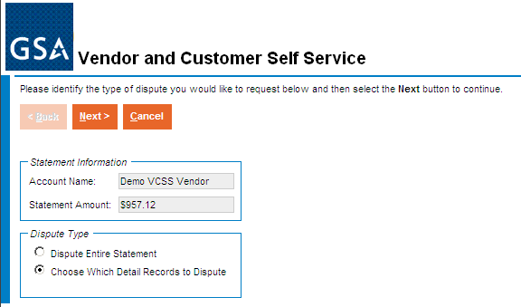
Dispute a Statement (Cont’d)
Select Dispute Type page
To dispute details of a statement, select Choose Which Detail Records to Dispute and then select the [Next] button.
When selecting this option, there is an additional step to search for and select the specific detail billing records to dispute.
Note: Statement details are only available for customers doing business with GSA's Fleet, Rent, Global Supply, and Automotive Purchases business lines.
E30
Notes:
If you want to dispute details of a statement, then select the Choose Which Detail Records to Dispute.

Slide 32
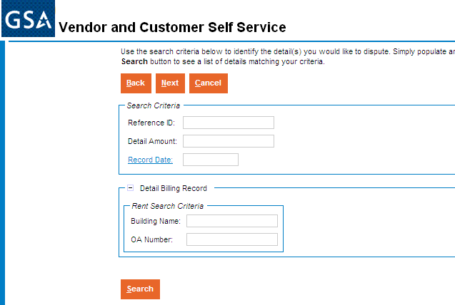
Dispute a Statement (Cont’d)
Select Detail Records to Dispute page
If you selected the option to choose which detail records to dispute, the third page of the dispute wizard displays to identify detail records for the dispute.
Select the [Search] button without entering search criteria.
If you have access to a large number of detail records, you may want to enter search criteria and select the [Search] button to limit the search results to a manageable number.
Note: Statement details are only available for customers doing business with GSA's Fleet, Rent, Global Supply, and Automotive Purchases business lines.
E31
Notes:
If you are disputing details of a statement, the wizard will add in this extra step for you to search for the specific detail records you would like to dispute.

Slide 33
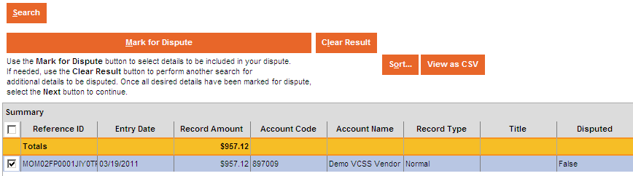
Dispute a Statement (Cont’d)
Select Detail Records to Dispute page
In the search results, select the detail record and then select the [Mark for Dispute] button to include the record in the dispute.
You have the option to select more than one detail record for the dispute.
Note: Statement details are only available for customers doing business with GSA's Fleet, Rent, Global Supply, and Automotive Purchases business lines.
E32
Notes:
After you find the detail of the statement you would like to dispute, select the detail record and select the [Mark for Dispute] button.
You may select more than one detail record for the dispute.

Slide 34
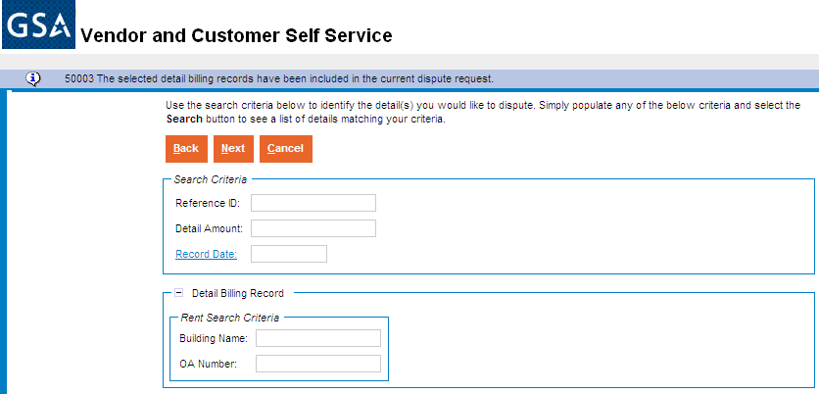
Dispute a Statement (Cont’d)
Select Detail Records to Dispute page
After you have successfully marked the detail records for dispute, review the system confirmation message and then select the [Next] button.
Note: Statement details are only available for customers doing business with GSA's Fleet, Rent, Global Supply, and Automotive Purchases business lines.
E33
Notes:
If you are disputing details of a statement, then you get a confirmation message that the detail record(s) has been included in the dispute request.

Slide 35
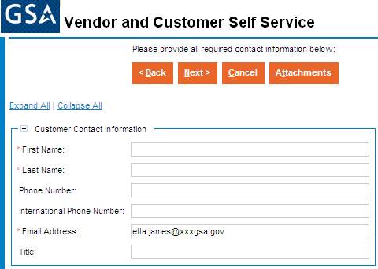
Dispute a Statement (Cont’d)
Enter Dispute Information page
This is the next page of the dispute wizard that displays after you do either of the following:
Select Dispute Entire Statement.
Select Choose Which Detail Records to Dispute, search for and successfully mark the detail records for dispute.
Enter your contact information.
E34
Notes:
Whether you are disputing the entire statement or details of a statement, the next step in the dispute wizard is to enter dispute information. Enter your contact information.

Slide 36
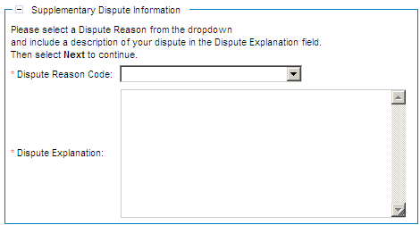
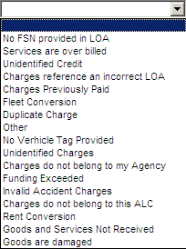
Dispute a Statement (Cont’d)
Enter Dispute Information page
Select a Dispute Reason Code and enter a detailed Dispute Explanation.
The Dispute Explanation field allows a maximum of 255 characters to be submitted.
E35
Notes:
Enter the Dispute Reason and include a written Explanation.

Slide 37
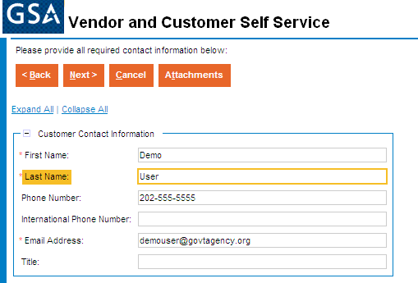
Dispute a Statement (Cont’d)
Enter Dispute Information page
If you would like to add supporting documentation to the dispute, select the [Attachments] button.
The attachment file types supported are text, PDF, Microsoft Excel and Word documents.
E36
Notes:
If you would like to add supporting documentation to your dispute, select the [Attachments] button.

Slide 38

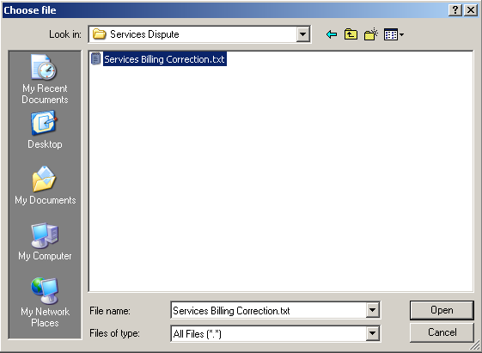
Dispute a Statement (Cont’d)
Add an Attachment to the Dispute
Select the [Browse] button search for a file on your computer.
In the choose file pop-up window, locate the file on your computer, select the file, and then select the [Open] button.
E37
Notes:
Select a file from your computer to attach.

Slide 39

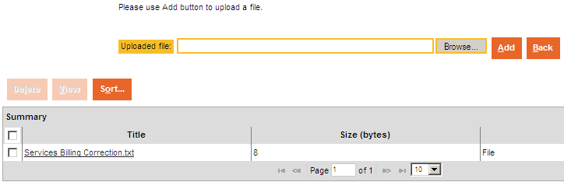
Dispute a Statement (Cont’d)
Add an Attachment to the Dispute
Confirm that the Uploaded file path displays, and then select the [Add] button to add this attachment.
If the attachment is successfully added, the attachment record displays in the attachments summary below. Select the [Back] button to return to the Dispute Information page.
If you would like to view the attachment, select the attachment record and then select the [View] button.
C:\Documents and Settings\etjames\Desktop\Services Dispute\Se
E38
Notes:
Add the attachment and then select the Back button to return back to the dispute information page.

Slide 40
Dispute a Statement (Cont’d)
Dispute Information page
Once you have entered the dispute information, and optionally added attachments if needed, select the [Next] button.
E39
Notes:
Once you have filled out the dispute information and optionally added an attachment, you can go on to the next step in the dispute wizard.

Slide 41
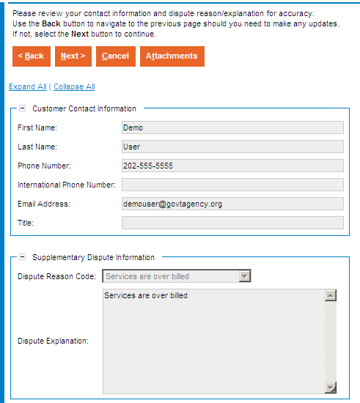
Dispute a Statement (Cont’d)
Confirm Dispute Information page
On the next page of the dispute wizard, confirm the dispute information you entered and then select the [Next] button.
If the dispute information you entered is not accurate, select the [Back] button to go back to the previous page and make updates as needed.
Note: If you added an attachment, it can be reviewed from this page by selecting the [Attachments] button.
On the attachments page review the attachment and then select the [Back] button to return back to this Confirm Dispute Information page.
E40
Notes:
This page is used to review the dispute request information you provided, and confirm that it is correct.

Slide 42
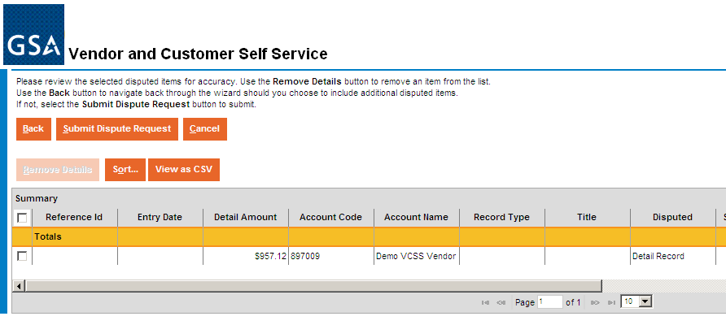
Dispute a Statement (Cont’d)
Submit Dispute page
The last page of the dispute wizard displays where you review the dispute and then select the [Submit Dispute Request] button.
If you would like to remove the dispute record(s), select the dispute record and then select the [Remove Details] button.
If the dispute is not correct, select the [Back] button to make updates to a previous page in the dispute wizard.
E41
Notes:
At this point, before you submit the dispute, you have the option to remove a detail record previously selected to be included in the dispute request.
When you are ready to submit the dispute, then select the [Submit Dispute Request] button.

Slide 43
Dispute a Statement (Cont’d)
Dispute Submitted
If the dispute request is submitted successfully, the VCSS home page displays with a confirmation message.
Once the dispute request has been submitted in VCSS, a workflow notification task is routed to GSA Finance to be researched.
Return to VCSS to view updates on the dispute processing.
The dispute request can now be viewed from the View Dispute Requests query.
E42
Notes:
The system displays a confirmation message once you successfully submit the dispute request.

Slide 44
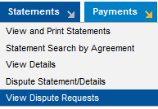
View Dispute Requests
The Dispute Requests Search Page is used to search for dispute requests.
Ability to search for dispute status using general, customer, and dispute criteria.
View specific information for each dispute such as the submitted date, the dispute reason, dispute explanation, last action date, and dispute resolution.
Provides dispute request status updates and GSA dispute resolution information.
To access the Dispute Requests Search page, from the menu bar select Statements > View Dispute Requests.
E43
Notes:
Provides the ability to search for dispute requests associated with your account

Slide 45
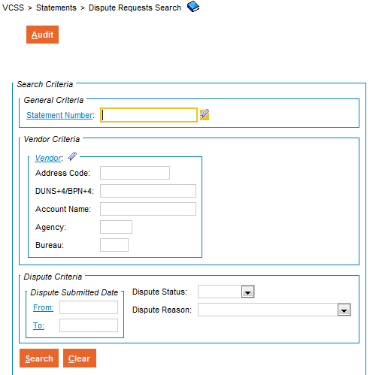
View Dispute Requests (Cont’d)
Dispute Requests Search page
The Dispute Requests Search page displays with a search criteria area to search for dispute requests.
Enter search criteria and select the [Search] button.
E44
Notes:
The Dispute Request Search page displays, with a search area to enter search criteria to search for statement records.
Search criteria includes:
Statement Number
Vendor Criteria (Vendor Code, Agency, Bureau, etc.)
Dispute Information (Dispute Submission Date, Dispute Status, Dispute Reason)

Slide 46
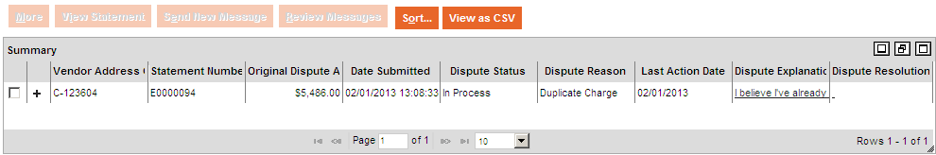
View Dispute Requests (Cont’d)
Dispute Requests Search page
Provides the ability to view specific information for each dispute, including:
Statement Number
Original Dispute Amount
Dispute Submitted Date
Dispute Status
Dispute Reason
Last Action Date
Dispute Explanation
Dispute Resolution
E45
Notes:
Go over the Statement number field
Original Dispute Amount
Date submitted
Dispute status
Dispute reason
Last Action Date
Dispute explanation
Dispute resolution

Slide 47
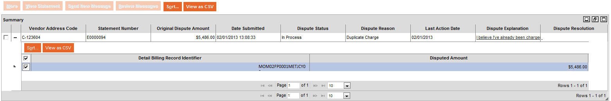
View Dispute Requests (Cont’d)
Dispute Requests Search page
If the dispute request was logged for specific records, the page provides the ability to view the Detail Billing Record Identifier and Disputed Amount.
Note: Statement details are only available for customers doing business with GSA's Fleet, Rent, Global Supply, and Automotive Purchases business lines
E46
Notes:
Explain that by clicking on the + , it opens up the Detail billing record identifier and the disputed amount.

Slide 48
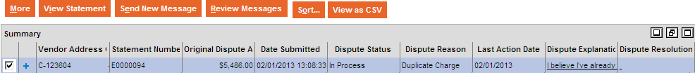
View Dispute Requests (Cont’d)
Dispute Requests Search page
Select the [View Statement] button to view the statement associated with the dispute request.
E47
Notes:
You can view the detailed information associated with the dispute by selecting a statement record and then clicking the [View Statement] button.

Slide 49
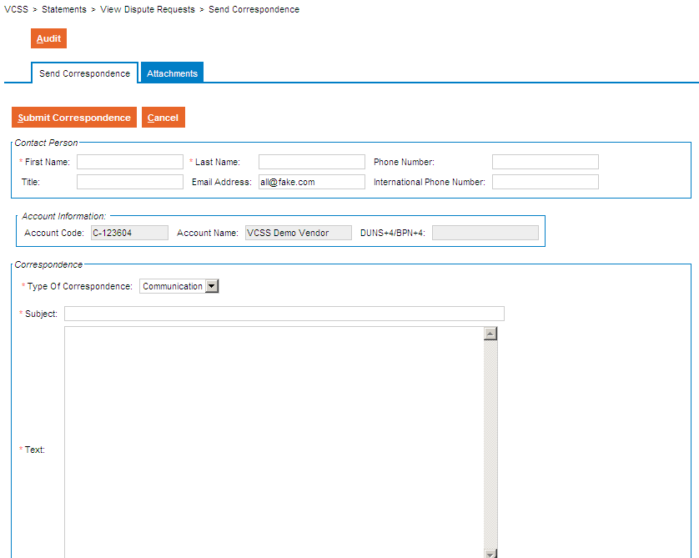
View Dispute Requests (Cont’d)
Dispute Requests Search page
Selecting the [Send New Message] button brings you to the Send Correspondence page.
E48
Notes:
Selecting the [Send New Message] button brings you to the Send Correspondence page

Slide 50
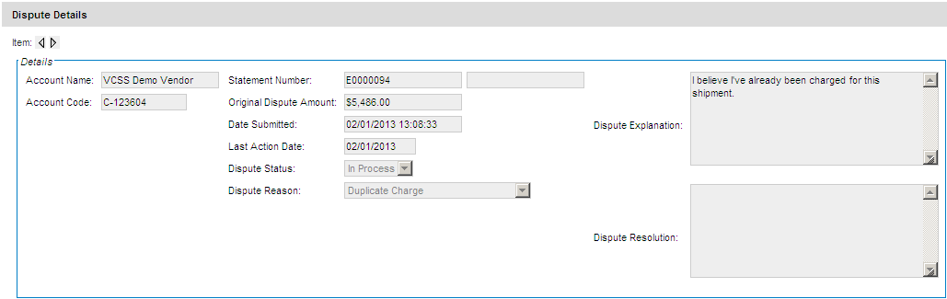
View Dispute Requests (Cont’d)
Dispute Requests Search page
To View the Details Screen, select a Statement Number and then select the [More] button.
The Dispute Details section displays details including the Account Name, Date Submitted, Dispute Status, and Dispute Reason.
Dispute Explanation and Dispute Resolution fields have a clickable value that when selected opens the Dispute Details section.
Dispute Resolution field will only have a clickable value if the dispute has been resolved.
E49
Notes:
Selecting the [More] button brings up the Dispute Details box

Slide 51
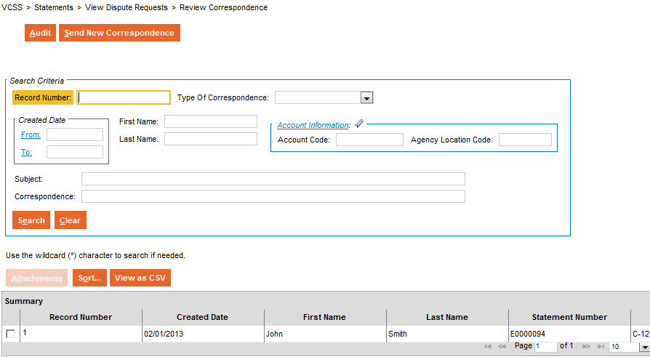
View Dispute Requests (Cont’d)
Dispute Requests Search page
Selecting the [Review Messages] button opens the Review Correspondence Page.
E50
Notes:
Selecting the [Review Messages button brings up the View Messages Page Dispute Details box

Slide 52

View Dispute Requests (Cont’d)
Review Correspondence Page
Provides correspondence information related to the dispute request.
E51`

